Slide 1


The Raspberry Pi
Board
Rakshak R Naik
IOT BCS701
Under the guidance of : Ms. Archana Ma’am

Slide 2
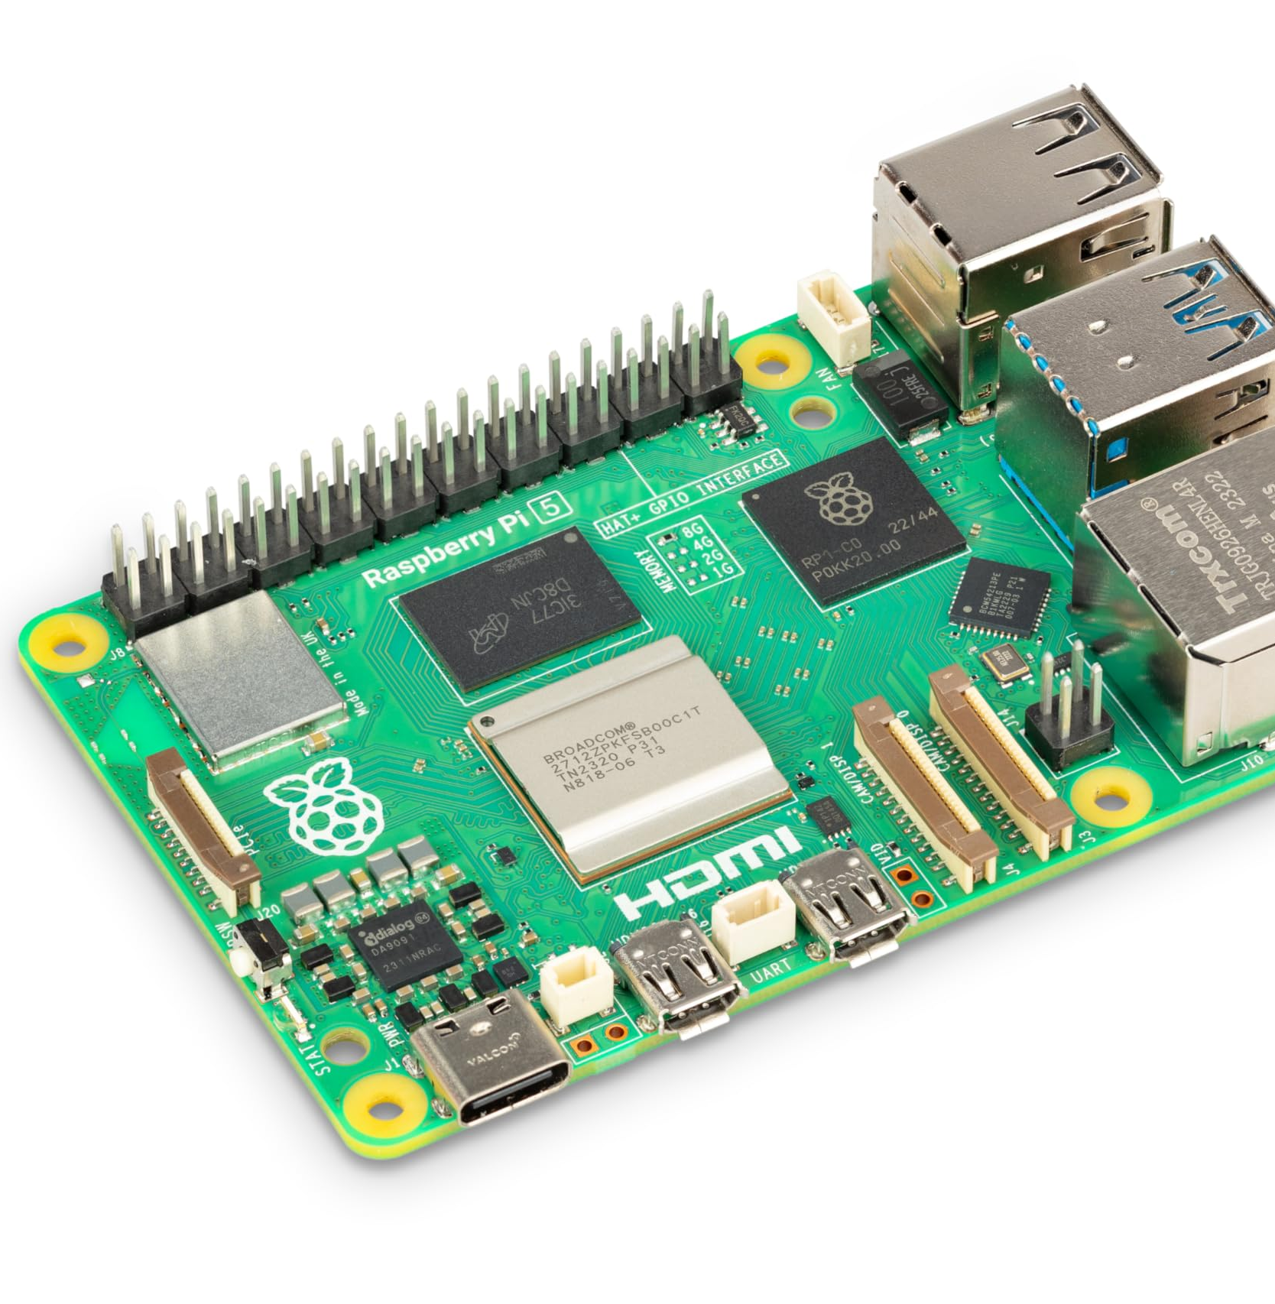
Introduction
Raspberry Pi is a low-cost, credit-card-sized computer.
Developed by the Raspberry Pi Foundation (UK).
Aims to promote computer science education and DIY electronics.
Used in education, prototyping, and IoT projects.

Slide 3
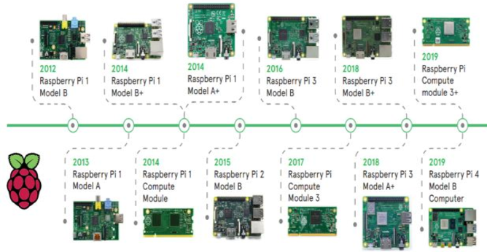
Evolution of Raspberry Pi
First model released in 2012.
Major versions: Pi 1 → Pi 2 → Pi 3 → Pi 4 → Pi 5 (2023).
Raspberry Pi Zero series for ultra-compact, low-power use.
Increasing power and features each generation. with

Slide 4
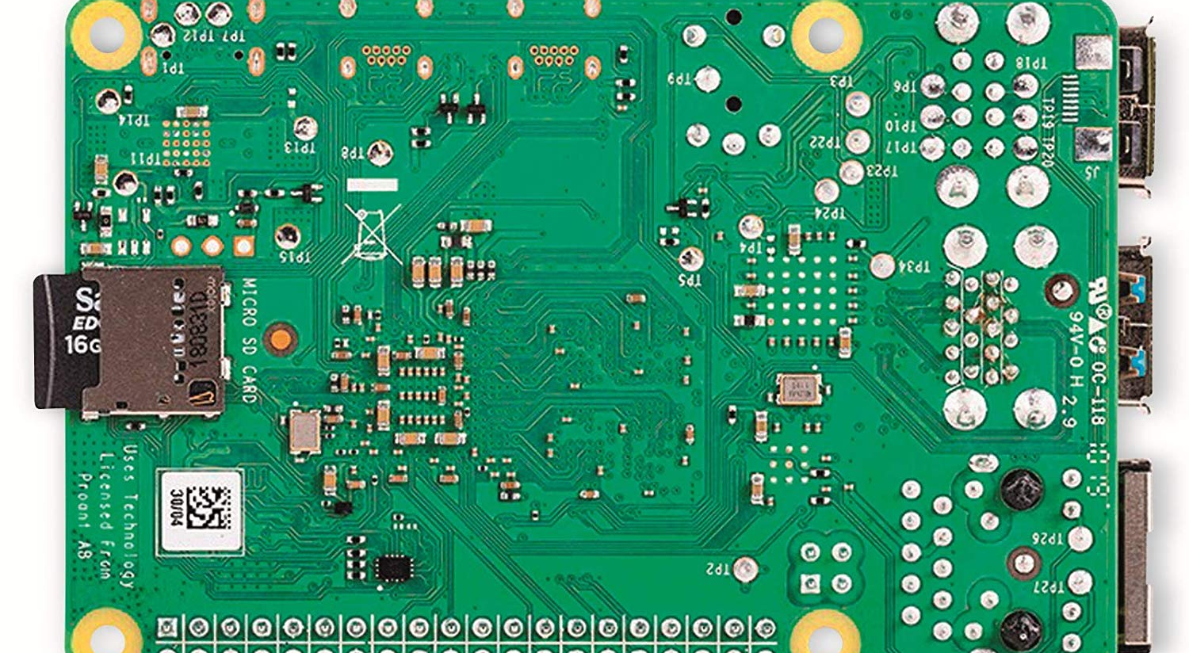
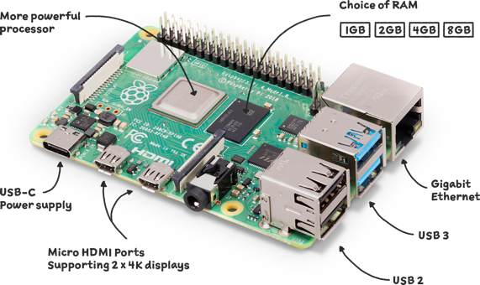
Hardware Overview
CPU: ARM-based processor.
RAM: 512 MB – 8 GB depending on model.
Ports: HDMI, USB, audio jack, Ethernet, camera interface.
GPIO (40-pin) for hardware interfacing.
Storage via micro-SD card.

Slide 5
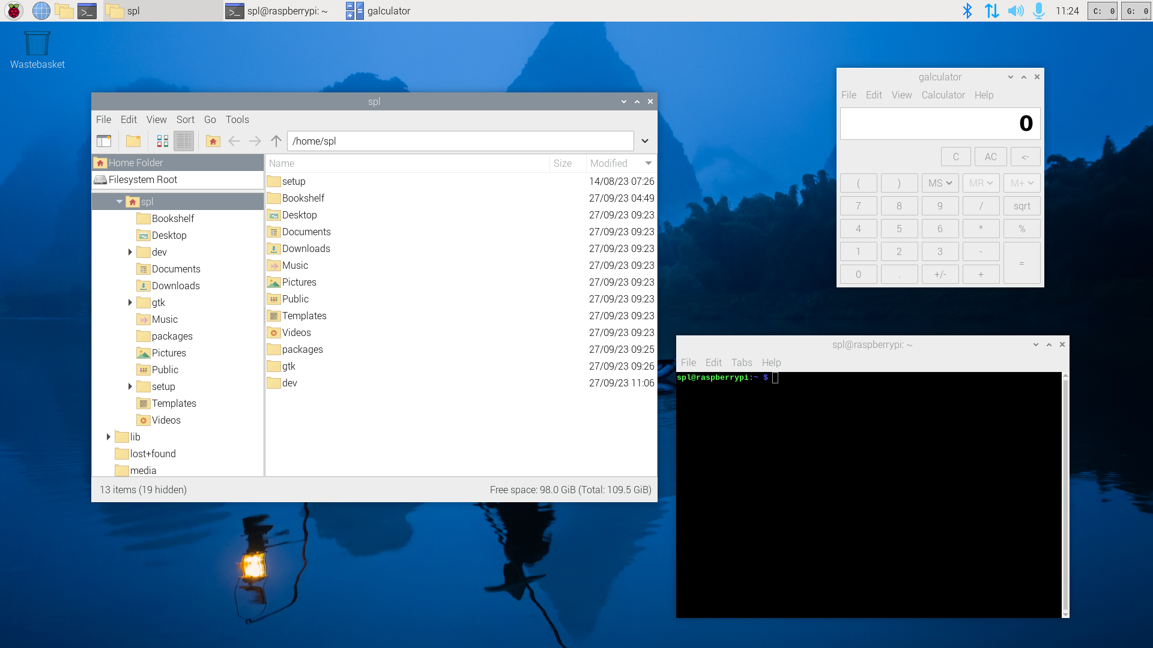
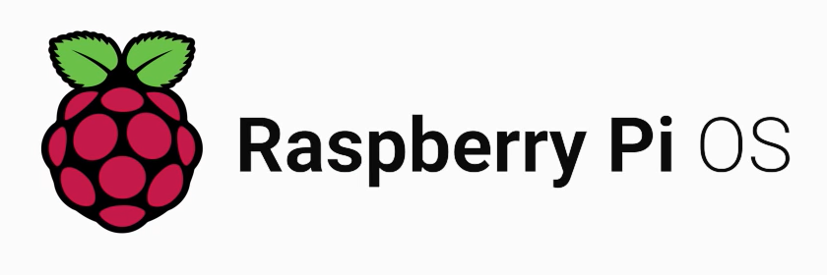
Operating Systems
Raspberry Pi OS (formerly Raspbian) – official OS.
Supports Ubuntu Server, Kali Linux, Windows IoT Core.
OS installed via Raspberry Pi Imager.
Bootable from SD card or USB.

Slide 6

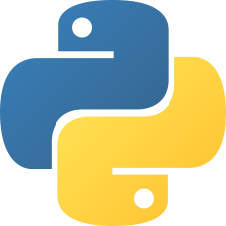

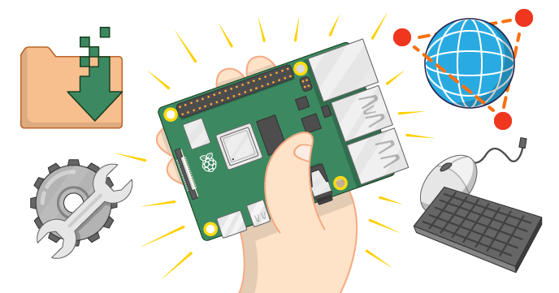
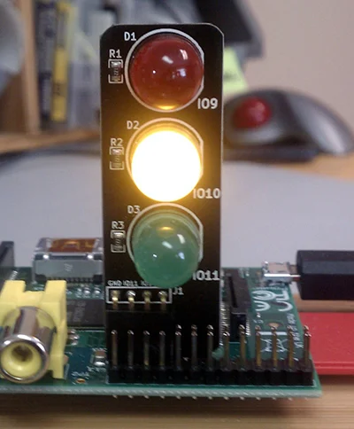
Software & Programming
Supports multiple languages: Python, C/C++, Java, Scratch.
Pre-installed tools: Thonny IDE, Geany, IDLE.
Common tasks: sensor data collection, automation, robotics.
Example: blink an LED using Python.

Slide 7
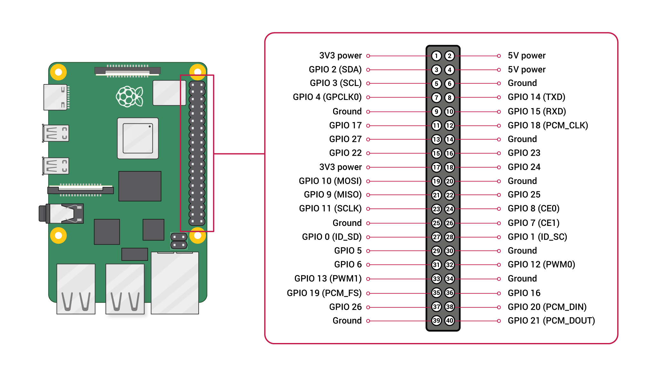
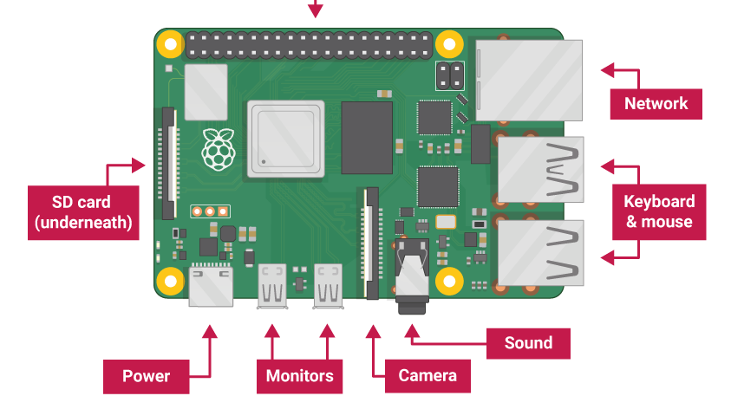
Networking & GPIO
40 GPIO pins for digital input/output.
Can control LEDs, motors, and read sensors.
Communication protocols: I²C, SPI, UART.
Ideal for learning embedded systems concepts.
Built-in Wi-Fi and Bluetooth on Pi 3 and later.
Ethernet port for wired networking.
Remote access via SSH or VNC.
Can host web servers or IoT dashboards.

Slide 8
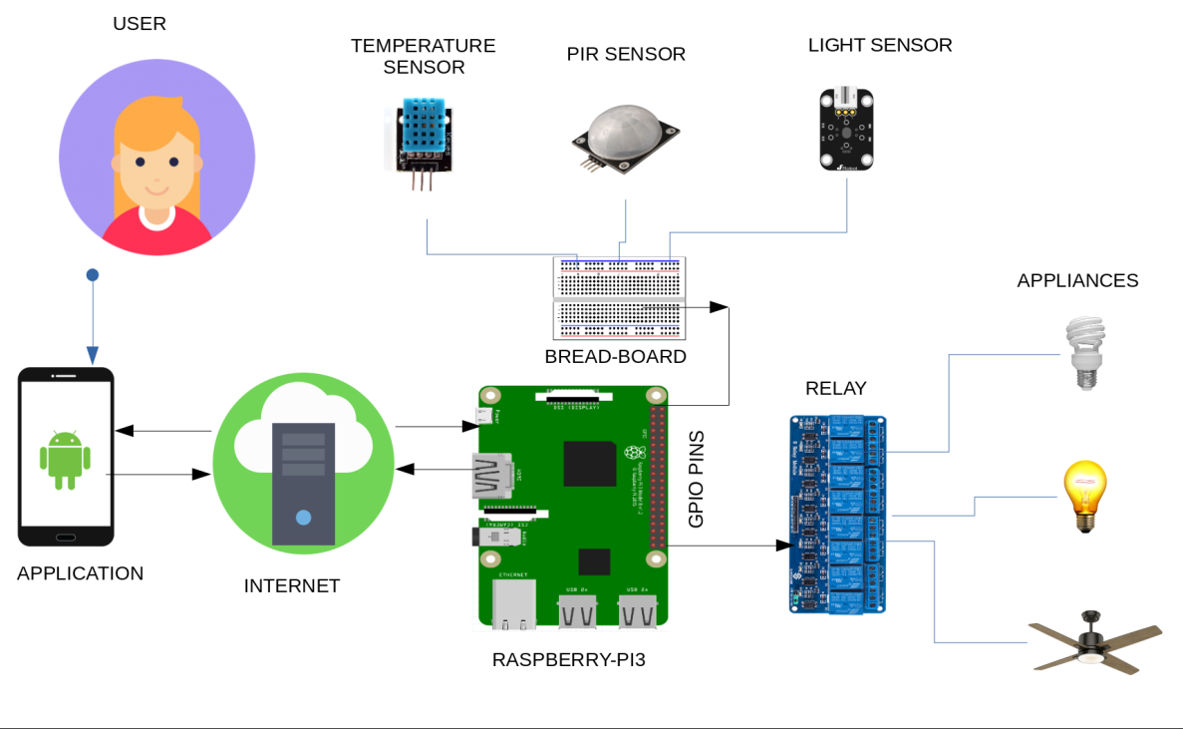
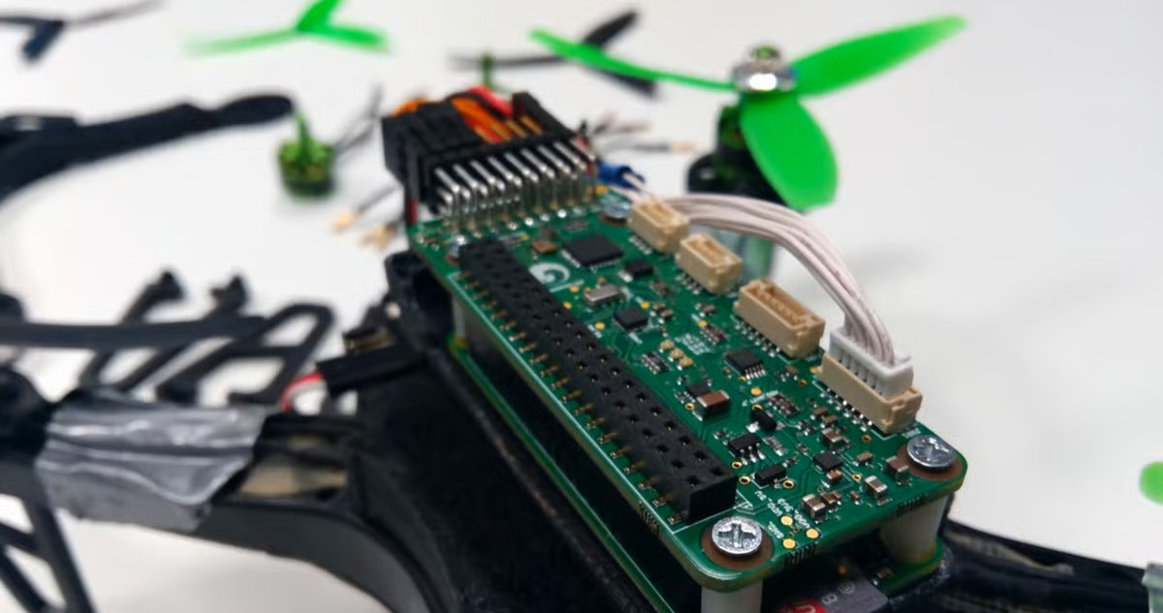
Applications & Projects
Smart Home Automation (System Monitoring, Lighting).
IoT and Sensor Networks.
Robotics and Drones.
Media Center (Kodi, RetroPie).
Edge AI – image recognition and ML inference.

Slide 9
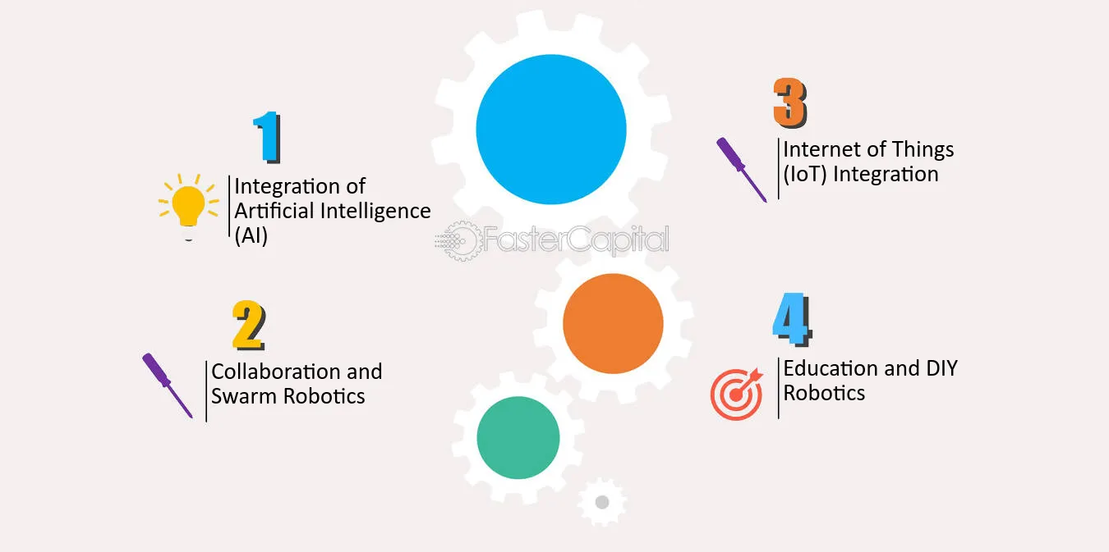
Limitations & Future Scope
Limitations
Limited processing power for heavy tasks.
No built-in storage; depends on external SD or USB drives.
Requires external components (monitor, keyboard).
Generates heat under continuous load.
Future Scope
Faster CPUs and better cooling in new models.
Integration with AI and IoT platforms.
Wider use in robotics and automation.
Expansion in education and research fields.

Slide 10
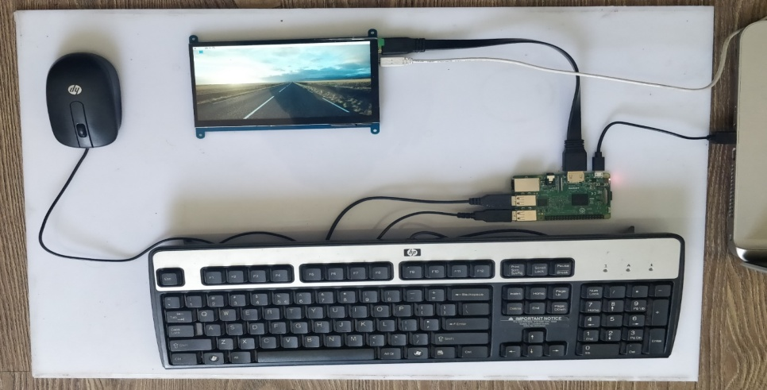
Conclusion
Raspberry Pi revolutionized low-cost computing.
Enables innovation in education and research.
A powerful tool for learning programming and electronics.
Inspires the next generation of tech enthusiasts.

Slide 11
THANK YOU

